Slide 1
Who we are
Creating two new companies
In early 2020, we started a two-year programme to prepare GSK for separation
into two new, exciting companies – a new
GSK in Biopharma and a new world leader
in Consumer Healthcare. We remain on
track to separate in 2022.
GSK is a science-led global healthcare company with a special purpose to improve the quality of human life by helping people do more, feel better, live longer.
Every day, we help improve the health
of millions of people around the world by discovering, developing and manufacturing
innovative medicines, vaccines and consumer healthcare products.
Snider-Desir
Scientific Investigator

Slide 2
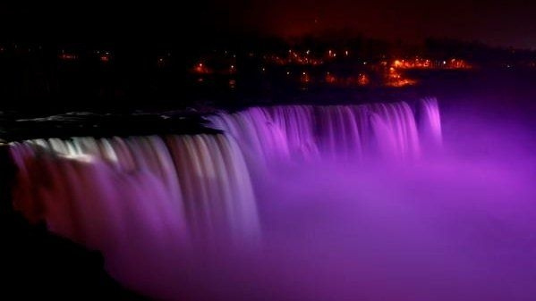


Introduction to PLU
#PurpleLightUp is a game-changing global movement led by PurpleSpace. It is designed to celebrate the economic contribution of employees with disabilities and is a mark of respect to the UN International Day of Persons with Disabilities every 3rd December.
#PurpleLightUp enables disability Employee Resource Groups / networks and their employers to accelerate culture change around the world.
Organisations that participate in #PurpleLightUp are signalling one, or more, of the following:
Their disability Employee Resource Group/Network matters to them and they value their leadership, challenge and innovation.
They are an ally to people with disabilities.
Disability is on their board agenda.

Slide 3

Why GSK chooses to go Purple for International Day for Persons with Disability
Celebrating the economic contribution of People with Disabilities globally
As a PurpleSpace strategic partner we support this global movement [#Purple Light-Up] by visibly promoting disability inclusion in a fun way
Purple branded events and activity advocating the value of building your disability confidence - in line with GSKs commitment to inclusion and diversity and our values as a company
Re-stating our commitment to disability pledges including: The Valuable 500 and the UK government’s Disability Confidence scheme
Adding GSK voice to importance in reaching customers/patients with disabilities

Slide 4
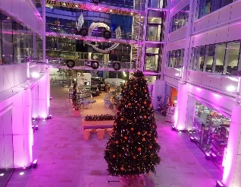
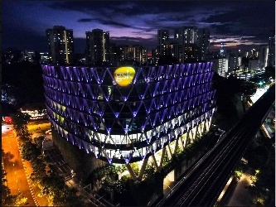
GSK lighting up Purple for International Day for Persons with disability
In 2019 we lit up our buildings…
GSK UK HQ interior
GSK Singapore HQ

Slide 5
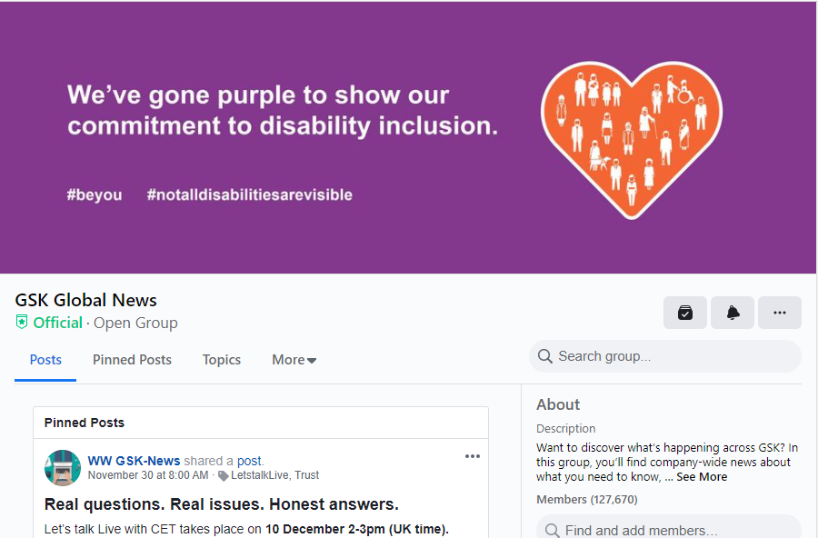
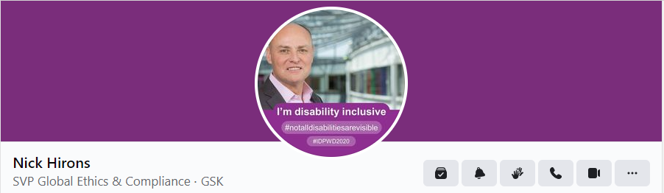
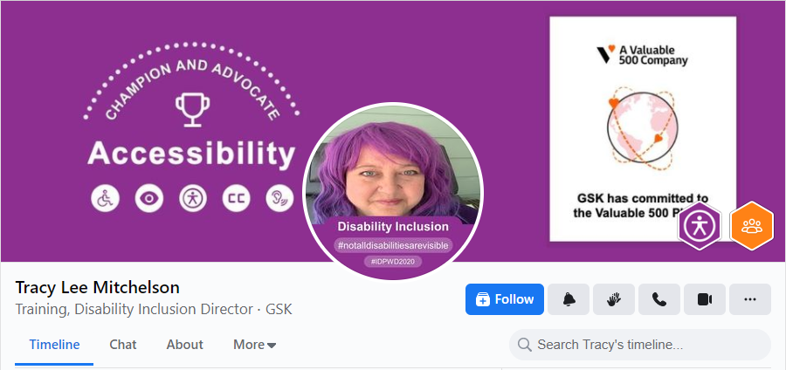
GSK lighting up Purple for International Day for Persons with disability
In 2020 we lit up our digital channels inside…

Slide 6
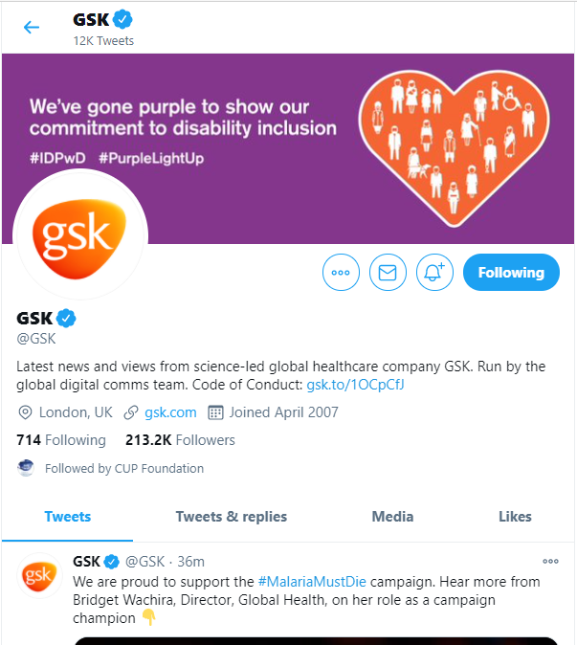
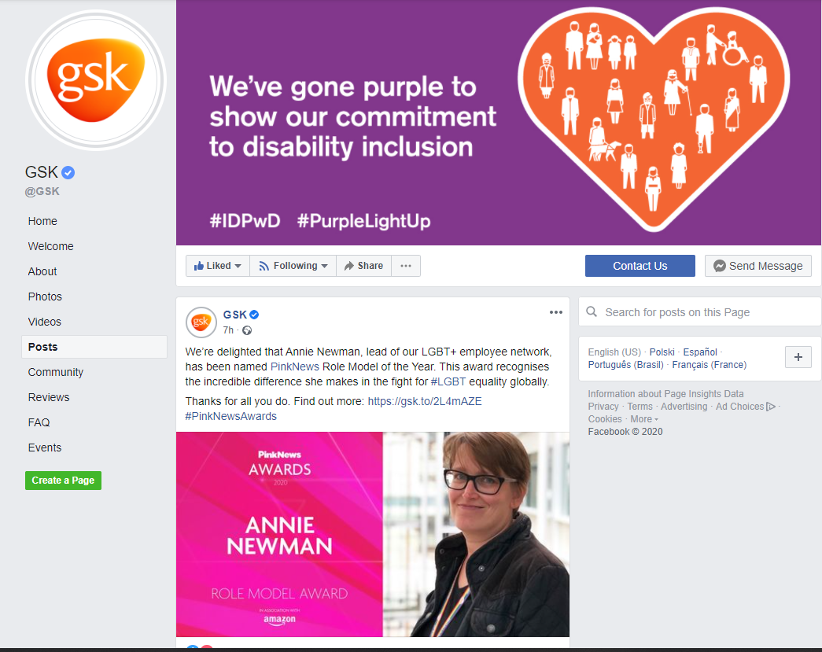
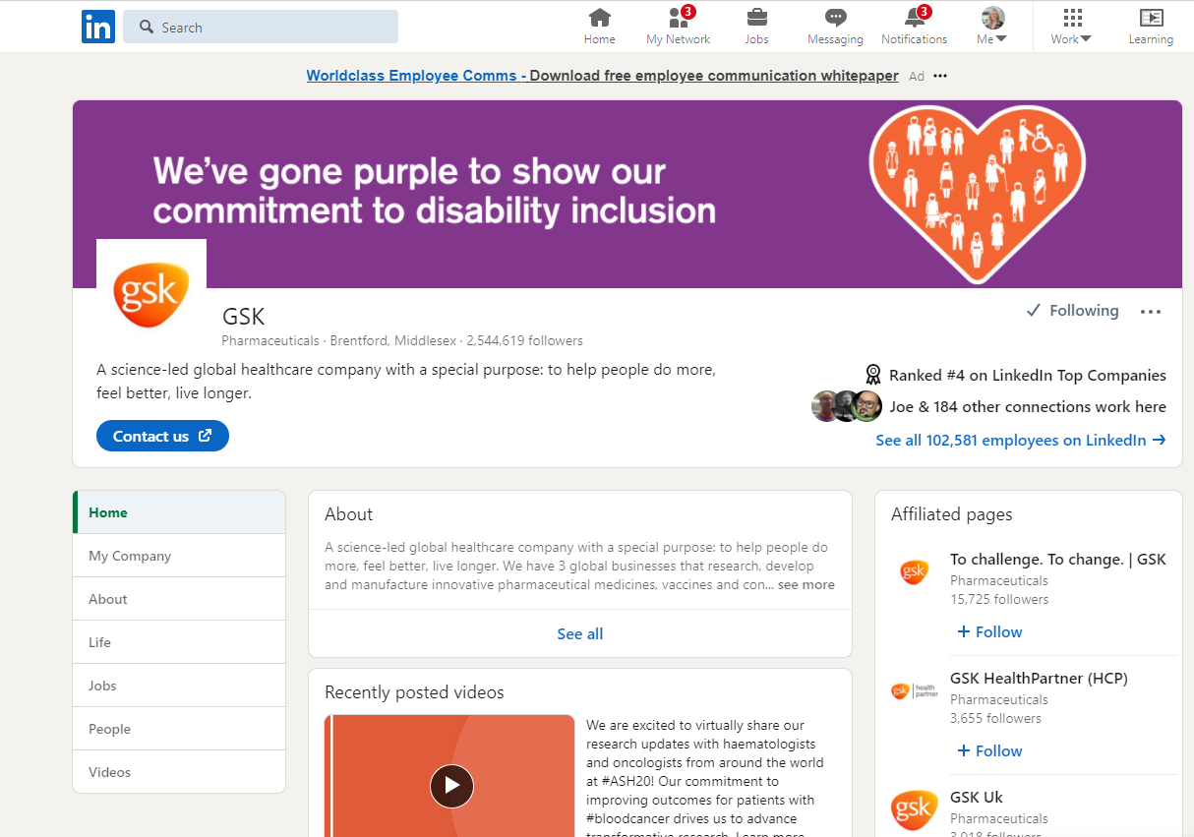
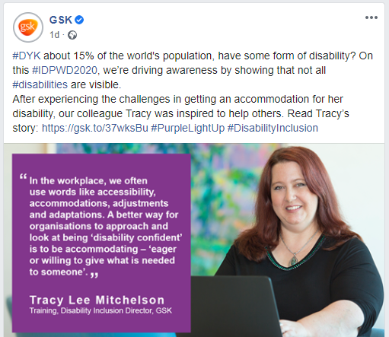
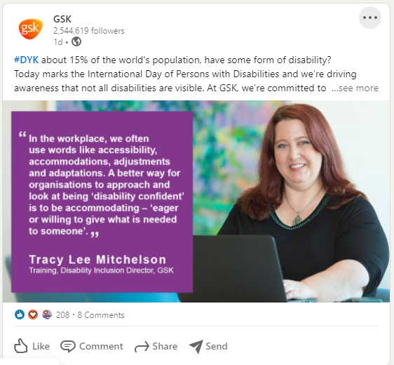
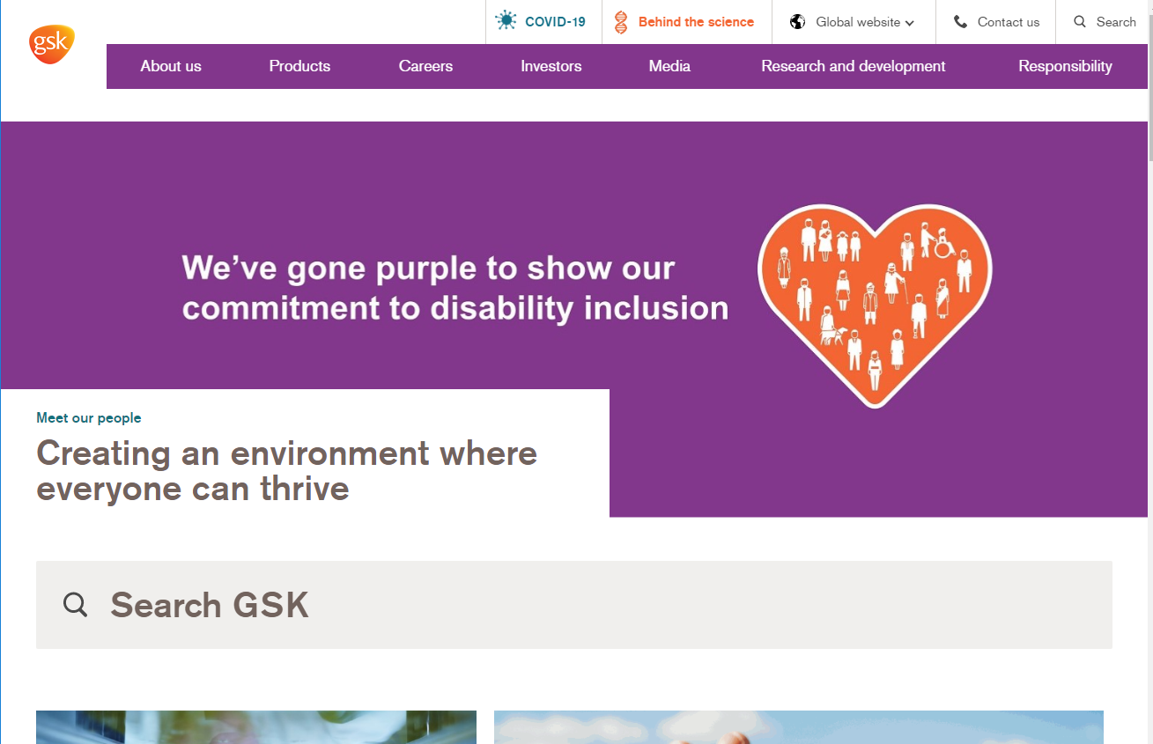
GSK lighting up Purple for International Day for Persons with disability
and outside of GSK.
Link to the ‘Creating an environment where everyone can thrive’ feature on IDPwD on GSK.com.

Slide 7
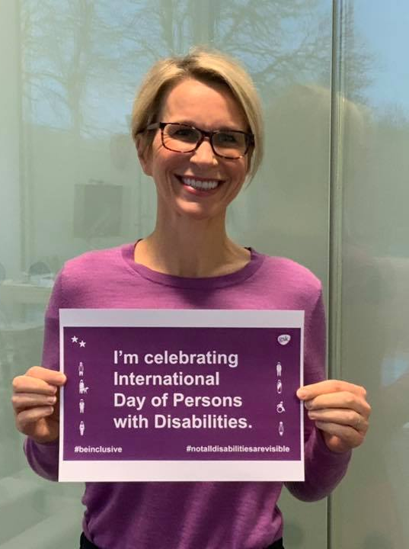
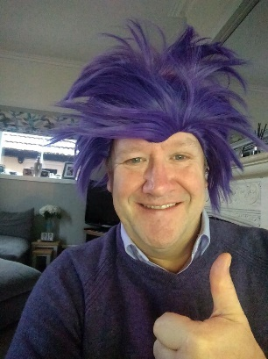
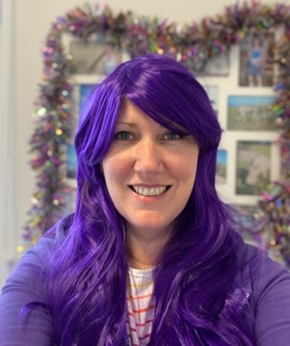
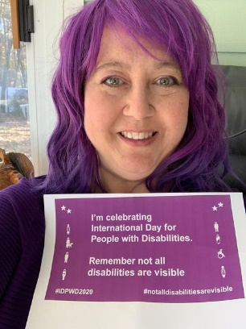
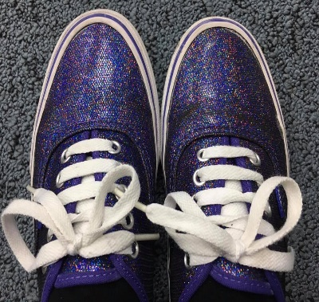
We continue to collectively and individually show our support for disability inclusion

Slide 8
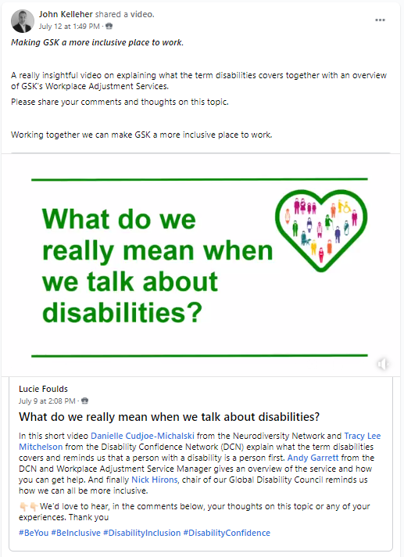
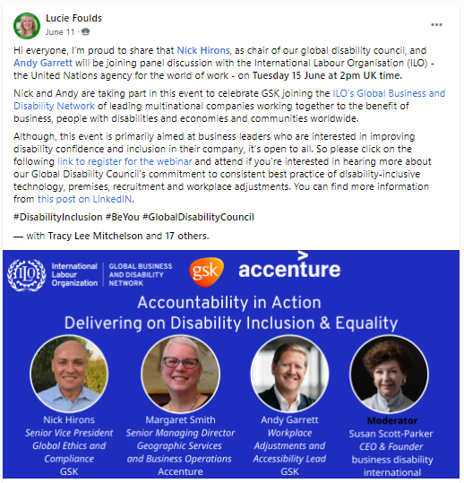
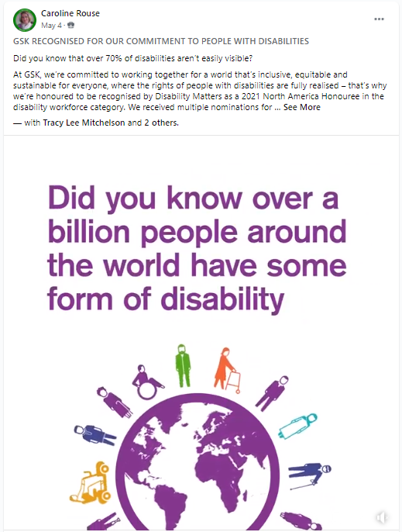
Why do we continue to take part in #Purple Light UP?
Purple Light Up is just one part of our communications strategy to build disability inclusion and confidence across GSK.
We use it as an opportunity to celebrate the contributions of people with disabilities and also reinforce key messages to help us deliver on the commitments we’ve made as part of our Valuable 500 pledge.

Slide 9
Insights from our 2020 #PurpleLightUp activity
Internal
Emma Walmsley (CEO) and Nick Hirons (Chair Global Disability Council) posts were widely shared on Workplace
Audience in the UK and US (just under and over 20,000 respectively) and great global reach with significant readership (over 1000) in Australia, Brazil, Canada, Egypt, France, Germany, India, Ireland, Italy, Japan, Malaysia, Mexico, Pakistan, Poland, Russia, Singapore, Switzerland.
External
Our content performed best on Twitter in regards to Engagement Rate and Click Through Rate with both performing over benchmark.
We were just under our desired engagement benchmark for our Instagram story.
Note: Our highest performing stories are pushed live on Fridays just before the weekend and also include quizzes.
International day for People with Disabilities (IDPWD) is on a Friday in 2021 and we’ll be making the most of this ☺

Slide 10
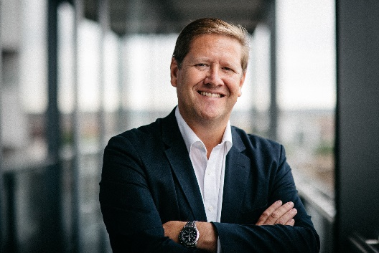
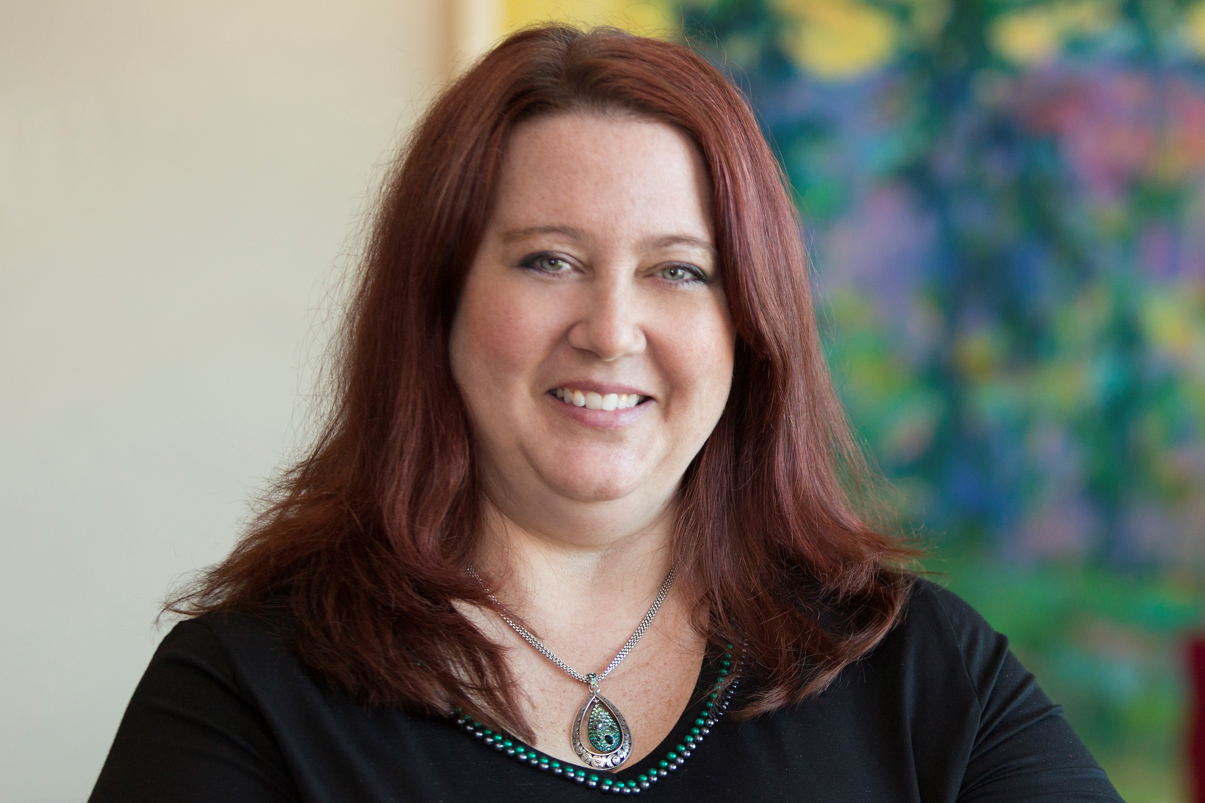
Quotes
Purple Light-Up is a brilliant opportunity each year for GSK to join in the fun of Going Purple, celebrating globally on [and around] International Day for Persons with Disability, sharing our commitment to the value of investing in people with disabilities in society and across our organisation.
Andy GARRETT
Workplace Adjustments Service global programme director
Co-lead GSK Disability Confidence Network - employee resource group and PurpleSpace founding ambassador
Purple Light-Up and International Day of Persons with Disabilities provides a platform that includes the recognizable Purple colour scheme to helps us spread the message of the importance of building disability inclusion and disability confidence globally. Coming together to celebrate difference and to highlight the work that still needs to be done to ensure we have equity for people with disabilities worldwide.
Tracy Lee Mitchelson
Training, Disability & Inclusion Director - Worldwide Real Estate and Facilities (WREF)
Co-lead GSK Disability Confidence Network - employee resource group

Slide 11

PLU links
#PurpleLightUp: https://www.purplespace.org/purple-light-up
PurpleSpace website: www.purplespace.org
Email: hello@purplespace.org
Twitter: @mypurplespace
LinkedIn: linkedin.com/company/purplespace
Facebook: facebook.com/mypurplespace
Building disability confidence from the inside out

